Slide 1
Operators And Expression
Sultan Mahmud
Lecturer
Department of ICT

Slide 2
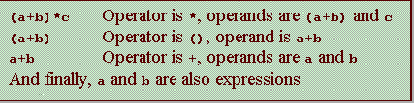
Operators and Expressions
Consider the expression A + B * 5 , where,
+ , * are operators,
A, B are variables,
5 is constant,
A, B and 5 are called operand, and
A + B * 5 is an expression.

Slide 3
Types of C operators
C language offers many types of operators, such as:
Arithmetic operators
Assignment operators
Increment/decrement operators
Relational operators
Logical operators
Bit wise operators
Conditional operators (ternary operators)
Special operators

Slide 4
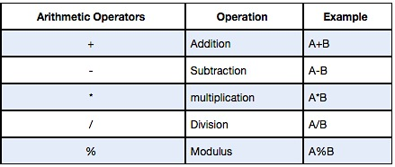
Arithmetic Operators
Arithmetic operators
Assignment operators
Inc/dec operators
Relational operators
Logical operators
Bit wise operators
Conditional operators
Special operators
C Arithmetic operators are used to perform mathematical calculations like addition, subtraction, multiplication, division and modulus in C programs.

Slide 5
Arithmetic Operators
Arithmetic operators
Assignment operators
Inc/dec operators
Relational operators
Logical operators
Bit wise operators
Conditional operators
Special operators
There are three types of arithmetic operations using arithmetic operators:
Integer arithmetic : when all operands are integer. If a=15 , b=10,
a + b =25
a / b =1 (decimal part)
a % b =5 (remainder of division)
Real arithmetic : All operands are only real number. If a=15.0 , b=10.0
a / b = 1.5
Mixed model arithmetic : when one operand is real and another is integer. If a=15 and b= 10.0
a / b = 1.5 whereas, 15/10=1
Note: The modulus operator % gives you the remainder when two integers are divided: 1 % 2 is 1 and 7 % 4 is 3.
The modulus operator can only be applied to integers.

Slide 6
Arithmetic Operators
Arithmetic operators
Assignment operators
Inc/dec operators
Relational operators
Logical operators
Bit wise operators
Conditional operators
Special operators
Integer arithmetic :
When an arithmetic operation is performed on two whole numbers or integers than such an operation is called as integer arithmetic.
It always gives an integer as the result.
Let x = 27 and y = 5 be 2 integer numbers. Then the integer operation leads to the following results.
x + y = 32
x – y = 22
x * y = 115
x % y = 2
x / y = 5

Slide 7
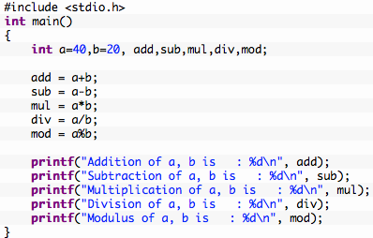
Example program for C arithmetic operators
Arithmetic operators
Assignment operators
Inc/dec operators
Relational operators
Logical operators
Bit wise operators
Conditional operators
Special operators
Output:
Addition of a, b is : 60
Subtraction of a, b is : 20
Multiplication of a, b is : 800
Division of a, b is : 2
Modulus of a, b is : 0

Slide 8
Arithmetic Operators
Arithmetic operators
Assignment operators
Inc/dec operators
Relational operators
Logical operators
Bit wise operators
Conditional operators
Special operators
Real arithmetic :
When an arithmetic operation is preformed on two real numbers or fraction numbers such an operation is called real or floating point arithmetic.
The modulus (remainder) operator is not applicable for floating point arithmetic operands.
Let x = 14.0 and y = 4.0 then
x + y = 18.0
x – y = 10.0
x * y = 56.0
x / y = 3.50

Slide 9
Arithmetic Operators
Arithmetic operators
Assignment operators
Inc/dec operators
Relational operators
Logical operators
Bit wise operators
Conditional operators
Special operators
Mixed mode arithmetic :
When one of the operand is real and other is an integer and if the arithmetic operation is carried out on these 2 operands then it is called as mixed mode arithmetic.
If any one operand is of real type then the result will always be real
Let x = 15 and y = 10.0 then
x / y = 1.5
Note that: 15 / 10 = 1 (since both of the operands are integer)

Slide 10
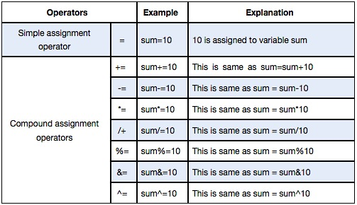
Assignment Operators
Arithmetic operators
Assignment operators
Inc/dec operators
Relational operators
Logical operators
Bit wise operators
Conditional operators
Special operators
In C programs, values for the variables are assigned using assignment operators.
For example, if the value “10″ is to be assigned for the variable “sum”, it can be assigned as sum = 10;
Shorthand or

Slide 11

Increment and Decrement Operators
Arithmetic operators
Assignment operators
Inc/dec operators
Relational operators
Logical operators
Bit wise operators
Conditional operators
Special operators
There are two more shorthand operators:
Increment _ _
Decrement ++
These two operators are for incrementing and decrementing a variable by 1.
For example, the following code increments i by 1 and decrements j by 1.

Slide 12
Increment and Decrement Operators
Arithmetic operators
Assignment operators
Inc/dec operators
Relational operators
Logical operators
Bit wise operators
Conditional operators
Special operators
The ++ and - - operators can be used in prefix or suffix mode, as shown in Table

Slide 13
Increment and Decrement Operators
Arithmetic operators
Assignment operators
Inc/dec operators
Relational operators
Logical operators
Bit wise operators
Conditional operators
Special operators
If the operator is before (prefixed to) the variable, the variable is incremented or decremented by 1, then the new value of the variable is returned.
If the operator is after (suffixed to) the variable, then the variable is incremented or decremented by 1, but the original old value of the variable is returned.
Therefore, the prefixes ++x and --x are referred to, respectively, as the preincrement operator and the predecrement operator; and the suffixes x++ and x -- are referred to, respectively, as the postincrement operator and the postdecrement operator.

Slide 14
Increment and Decrement Operators
Arithmetic operators
Assignment operators
Inc/dec operators
Relational operators
Logical operators
Bit wise operators
Conditional operators
Special operators
The prefix form of ++ (or --) and the suffix form of ++ (or --) are the same if they are used in isolation, but they cause different effects when used in an expression. The following code illustrates this:
In this case, i is incremented by 1, then the old value of i is returned and used in the multiplication. So newNum becomes 100. If i++ is replaced by ++i as follows,
i is incremented by 1, and the new value of i is returned and used in the multiplication. Thus newNum becomes 110.

Slide 15
Exercise on ++ and - -
Arithmetic operators
Assignment operators
Inc/dec operators
Relational operators
Logical operators
Bit wise operators
Conditional operators
Special operators
int x=2 , y = 5 , z = 0;
x++ ; y++ ;
x=y++ + x++;
y=++y + ++x;
y=++y + x++;
y += ++y;
y += 1 + (++x);
y += 2 + x++;

Slide 16
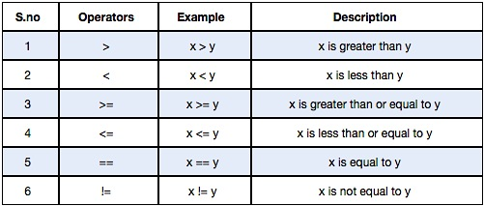
Relational Operators
Arithmetic operators
Assignment operators
Inc/dec operators
Relational operators
Logical operators
Bit wise operators
Conditional operators
Special operators
Relational operators are used to find the relation between two variables. i.e. to compare the values of two variables.

Slide 17
Exercise
int i=10, j=20, k=30;
float f=5.5;
char ch=‘A’;
i < j
(j+k)>=(i+k)
i+f <=10
i+(f <=10)
ch==65
ch >= 10*(i+f)

Slide 18
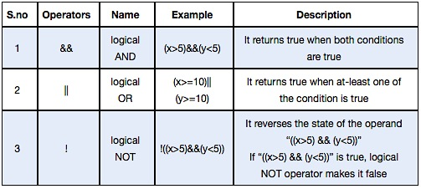
Logical Operators
Arithmetic operators
Assignment operators
Inc/dec operators
Relational operators
Logical operators
Bit wise operators
Conditional operators
Special operators
These operators are used to perform logical operations on the given expressions.
There are 3 logical operators in C language. They are, logical AND (&&), logical OR (||) and logical NOT (!).

Slide 19
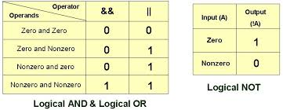
Logical Operators

Slide 20
Exercise
Given that: int a = 5, b = 2, c = 4, d = 6,, e = 3 ; What is the result of each of the following relational expressions?
a > b
a != b
d % b == c % b
a * c != d * b
d * b == c * e
a * b < a % b * c
c % b * a == b % c * a
b % c * a != a * b
d % b * c > 5 || c % b * d < 7
d % b * c > 5 && c % b * d < 7

Slide 21
Exercise
For each of the following statements, assign variable names for the unknowns and rewrite the statements as relational expressions.
A customer's age is 65 or more.
The temperature is less than 0 degrees and greater than -15 degrees.
A person's height is in between 5.8 to 6 feet.
The current month is 12 (December).
The person's age is 65 or more but less than 100.
A number is evenly divided by 4 or 400 but not with 100
A person is older than 55 or has been at the company for more than 25 years.
A width of a wall is less than 4 meters but more than 3 meters.
An employee's department number is less than 500 but greater than 1, and they've been at the company more than 25 years.

Slide 22
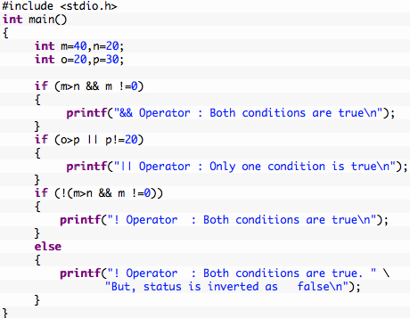
Example program for logical operators in C
Arithmetic operators
Assignment operators
Inc/dec operators
Relational operators
Logical operators
Bit wise operators
Conditional operators
Special operators
Output:
&& Operator : Both conditions are true
|| Operator : Only one condition is true
! Operator : Both conditions are true. But, status is inverted as false

Slide 23
Try this example program and explain the results
#include<stdio.h>
int main()
{
int a=5, b=-7, c=0, d;
d = ++a && ++b || ++c;
printf("\n %d %d %d %d",a,b,c,d);
}

Slide 24
Bit wise Operators
Arithmetic operators
Assignment operators
Inc/dec operators
Relational operators
Logical operators
Bit wise operators
Conditional operators
Special operators
One of C’s powerful features is a set of bit manipulation operators. These permit the programmer to access and manipulate individual bits within a piece of data to perform bit operations. The various Bitwise Operators available in C are shown in Figure
Decimal values are converted into binary values which are the sequence of bits and bit wise operators work on these bits.
These operators can operate upon ints and chars but not on floats and doubles.

Slide 25
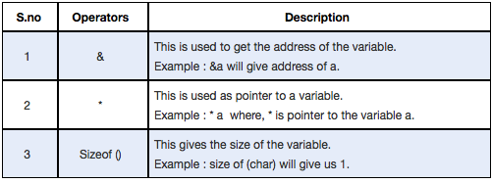
Special Operators
Arithmetic operators
Assignment operators
Inc/dec operators
Relational operators
Logical operators
Bit wise operators
Conditional operators
Special operators

Slide 26
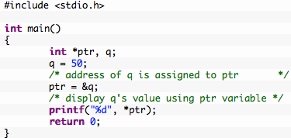
Example program for Special operators in C

Slide 27
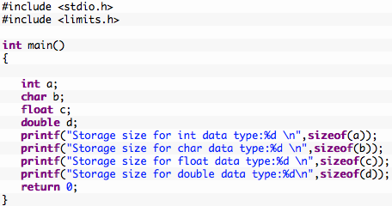
Example program for sizeof() operator in C
Output:
Storage size for int data type:4
Storage size for char data type:1
Storage size for float data type:4
Storage size for double data type:8

